Slide 1
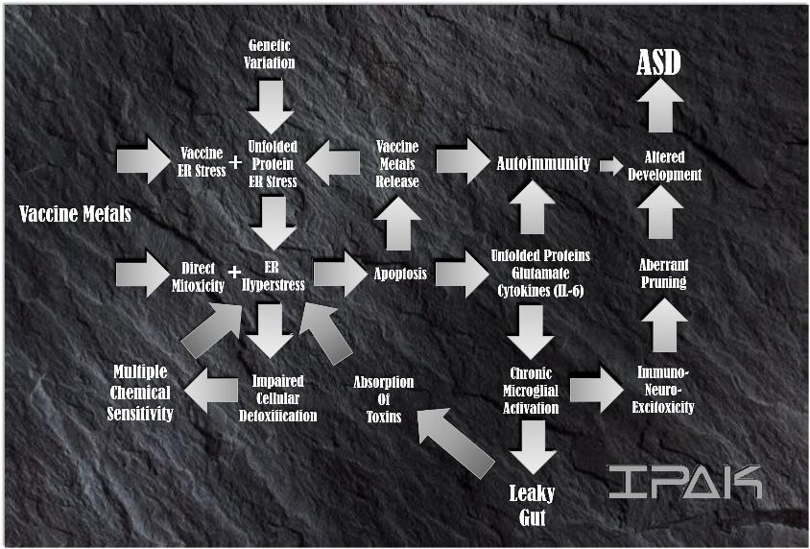
The ER Hyperstress Theory of Autism and Autoimmunity
James Lyons-Weiler, PhD CEO & President

Slide 2
The Institute for Pure and Applied Knowledge

Slide 4
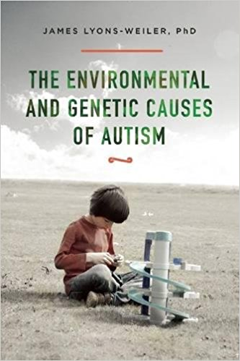
“Causes” : 2015 (Skyhorse)
1,000 studies cited
With Forward by Dr. Richard Frye
Searchable reference database at
http://envgencauses.com

Slide 5
“Autism” is Not Genetic

Slide 6
“ASD” is a Mixture of Phenotypes

Slide 7
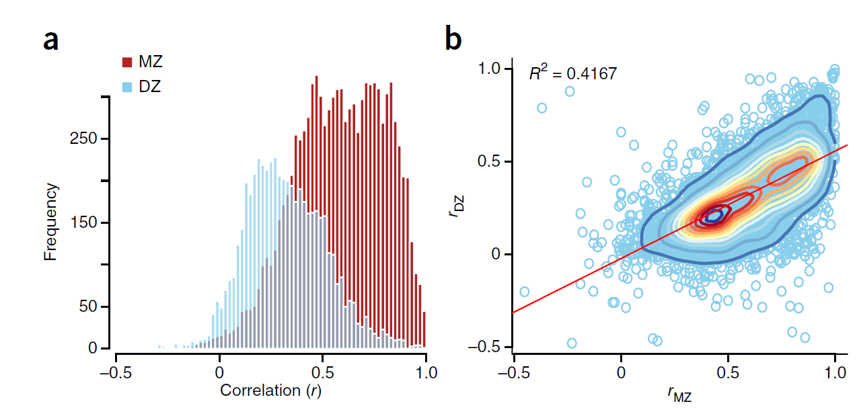
Heritability, >2,000,000 estimates (any human traits): 1958-2012 (Polderman et al.)

Slide 8
Genetics
>850 genes “involved” in Autism
No individual gene accounts for >1% of ASD
20% of autistics have >> Copy Number Variations (CNVs)
de Novo variants more common in sporadic vs. familial cases
regulatory genes in early development
synaptogenesis throughout life
Familial vs. Genetic Risk
Every mode of inheritance (dominant, recessive, complex)
Pinto >2-3 affected genes > ASD risk

Slide 9
Functional Groups by Age
-9 mo to 0 years
Early (pre-natal) regulatory genes
CHD7, CHD8 (neural crest, neurogenesis)
0- 2years
Peri/post-natal brain development
Synaptogenesis, PRUNING
2-4 years
PRUNING, MYELINATION
Lifetime
Synaptic proteins
Glutamate receptors
Serotonin receptors (e.g., SCN1A)
Cellular detox proteins (ERAP1)
Mitochondrial genes (ROS)

Slide 10
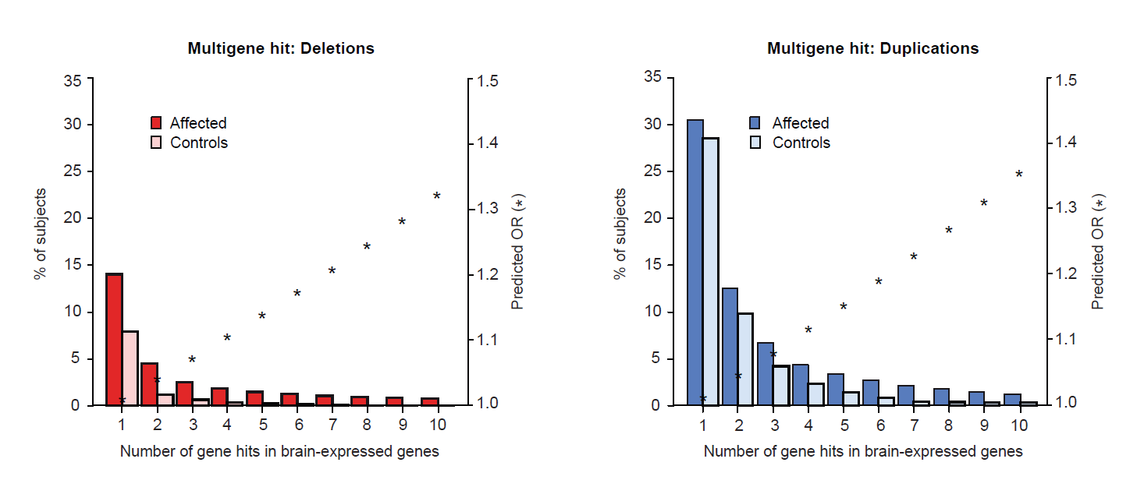
Pinto et al

Slide 11
Largest Genetic Studies (Hallmayer, 2011; Sandin, 2014)
Did not measure any environmental factors
Did not estimate G x E interactions
Both concluded around 50% E, 50% G

Slide 12
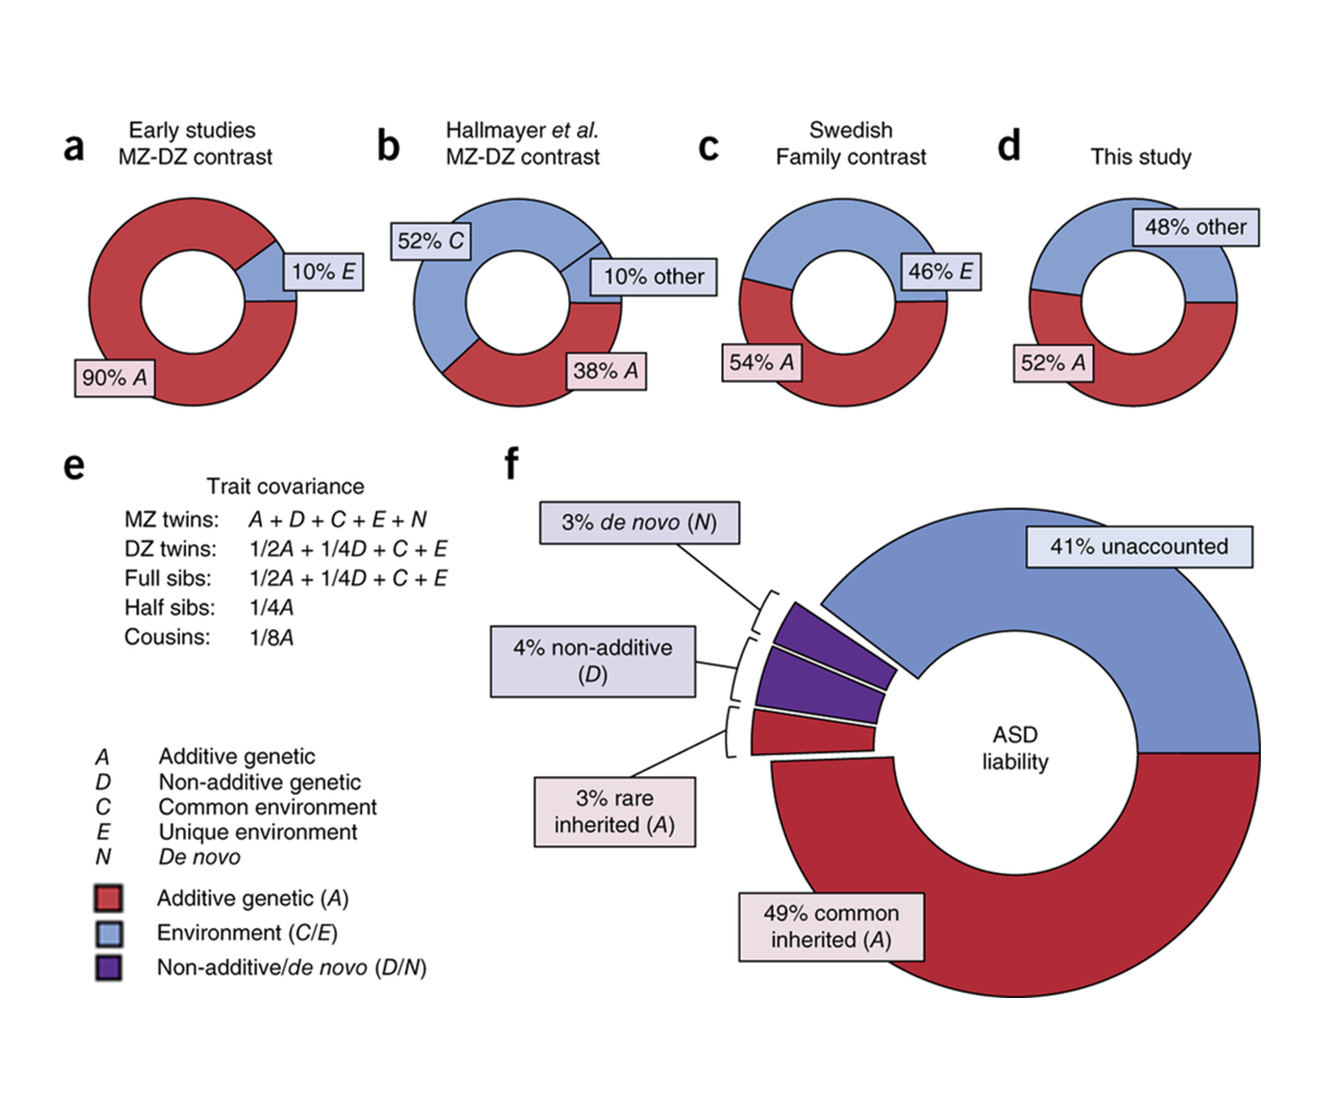
Environment,
G x E,
and
Gene x gene
Interactions
Inherited common,
Universal
environment
Gaugler T et al.
Most genetic risk for autism resides with common variation.
Nat Genet. 2014 Aug;46(8):881-5. doi: 10.1038/ng.3039. Epub 2014 Jul 20.

Slide 13
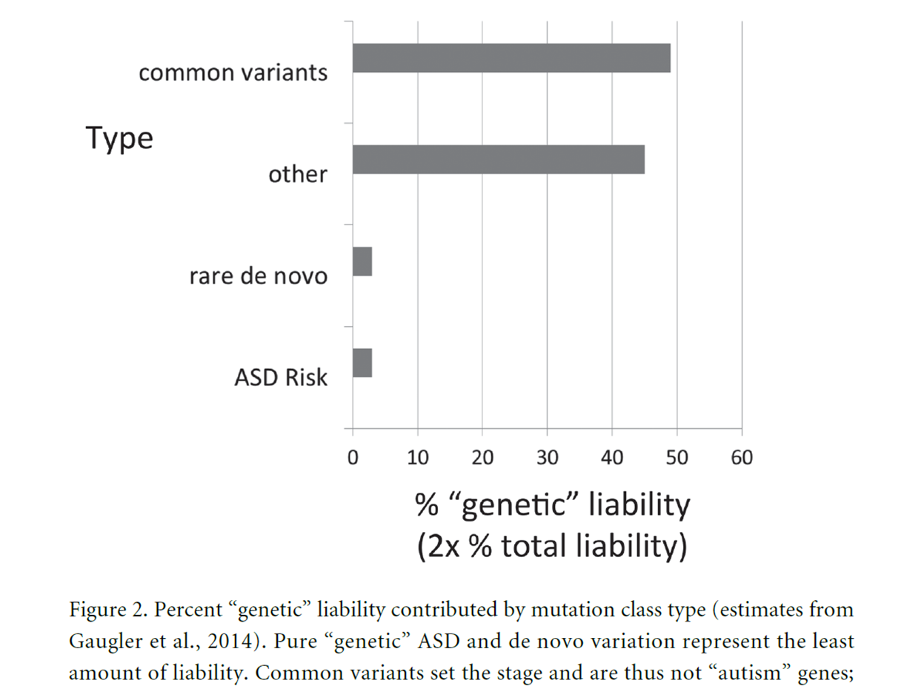
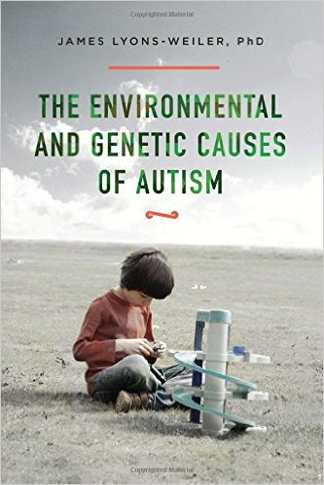

Slide 14
“Risk of Environmental Susceptibility” is Genetic

Slide 15
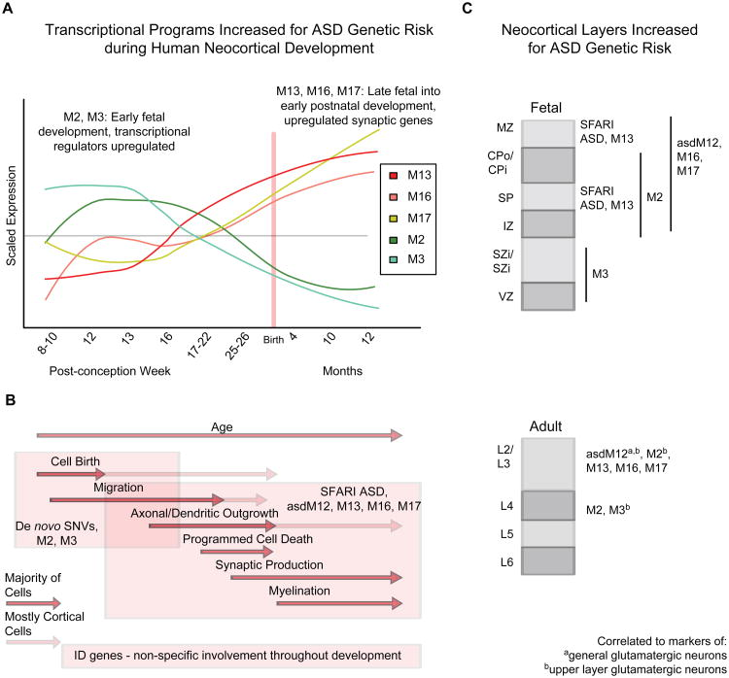
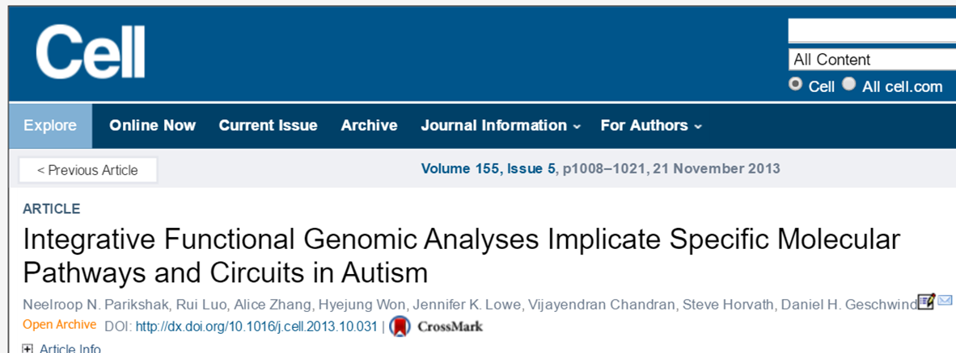
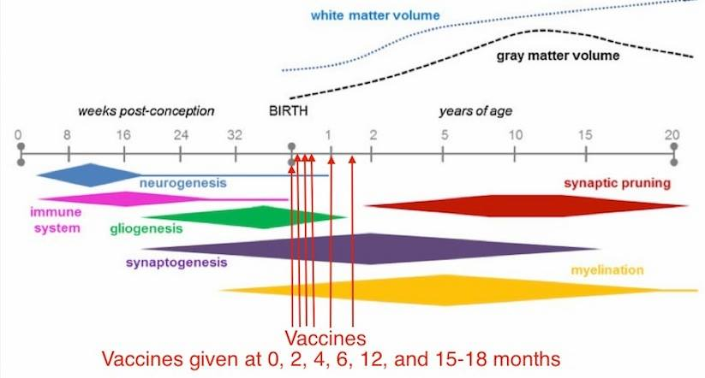
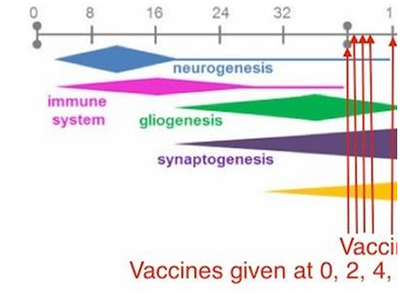

Slide 16
Boggess et al. 2016. Mean serum-level of common organic pollutants is predictive of behavioral severity in children with autism spectrum disorders. Sci Rep. 2016 May 13;6:26185. doi: 10.1038/srep26185.

Slide 17
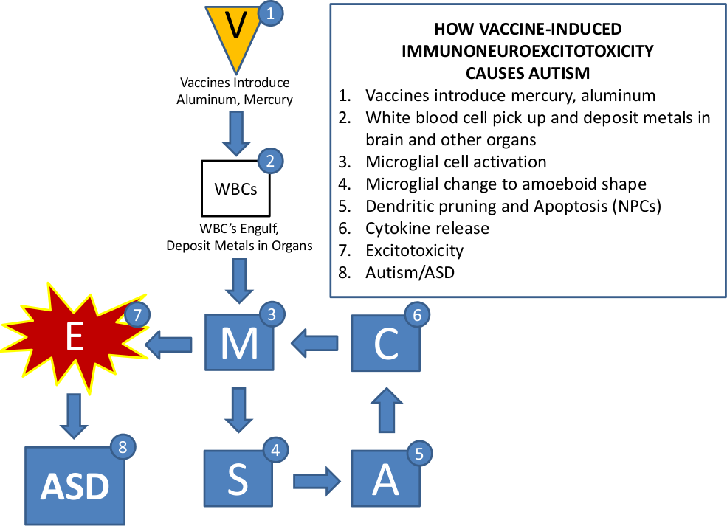

Slide 21
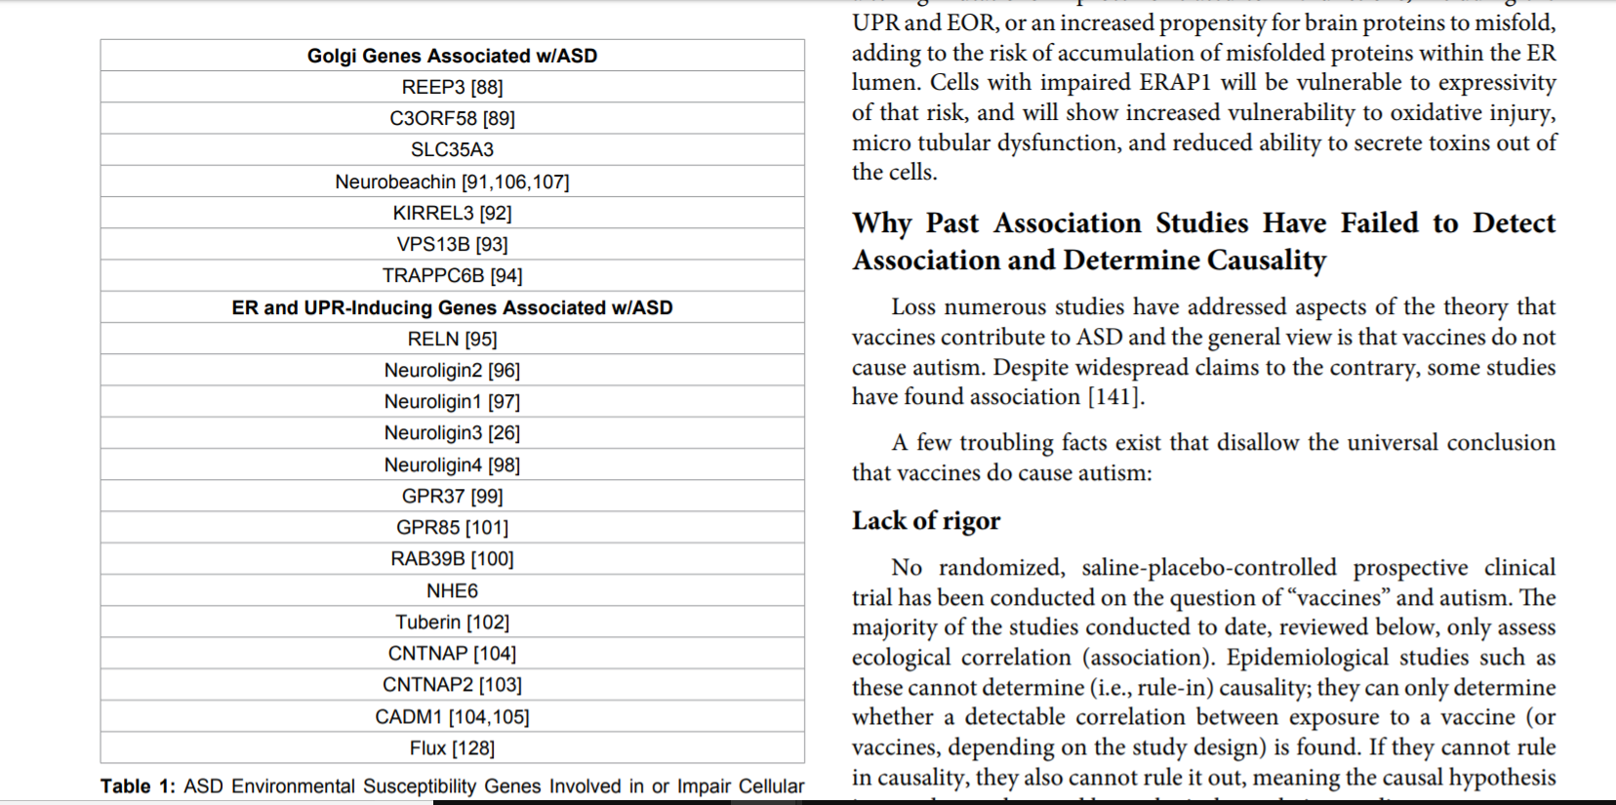

Slide 22
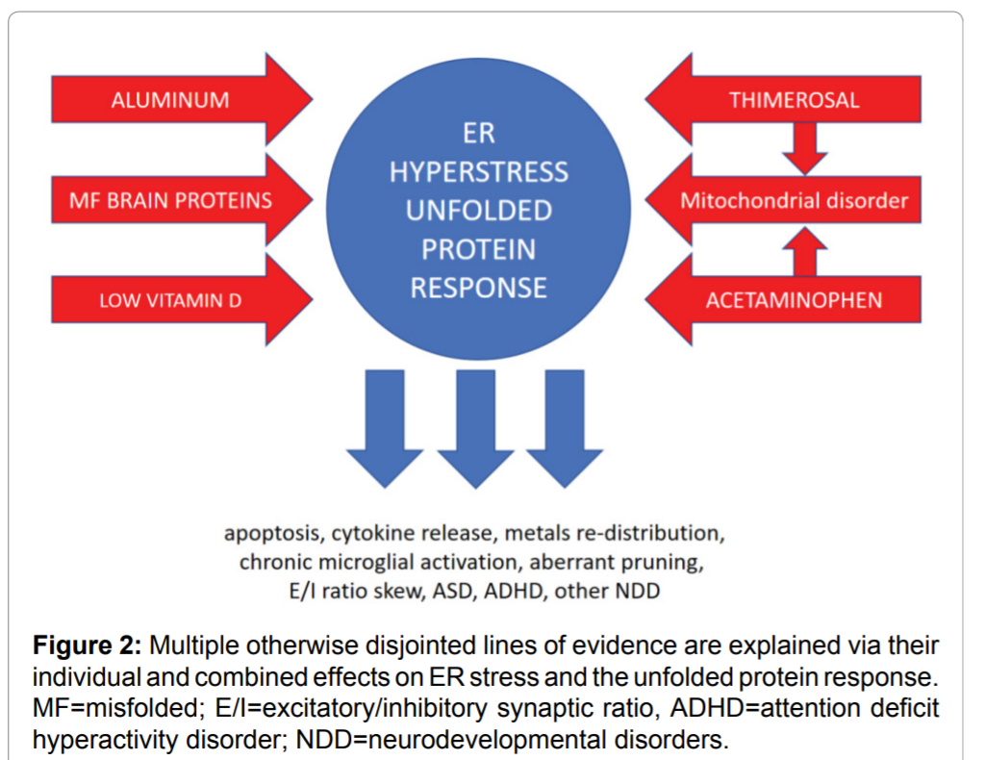

Slide 23
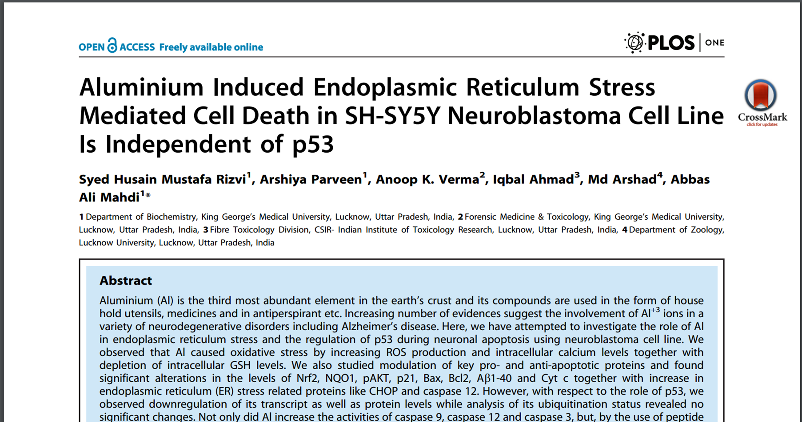

Slide 24
Environmental Toxin Liability Sampling Theory
Aluminum levels in vaccines are unsafe
We need to Risk Factors + Biomarkers Vaccine Safety Screening
Valproic acid
Pregnancy-related stress
thimerosal
PON1
CHD7
ADRB2
organophosphates
ERAP1
MTHFR
CBS
COMT
MET
particulate air pollution
Pre/peri-natal vitamins

Slide 25
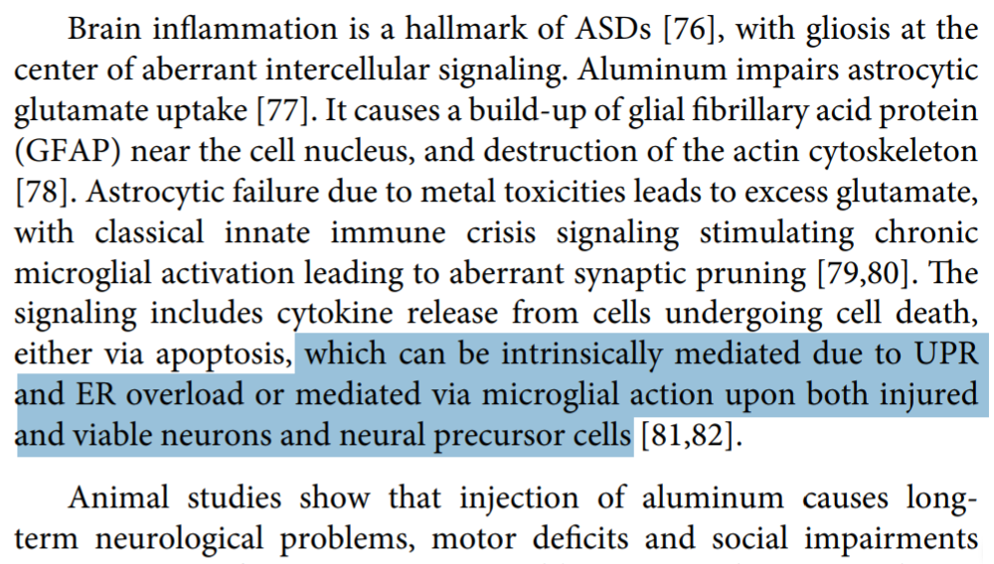

Slide 26
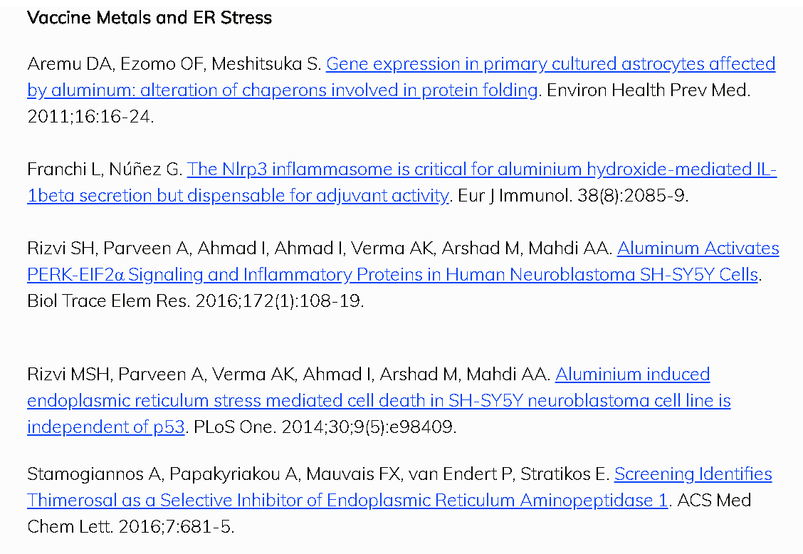

Slide 27
EtHg -> UPR -> Apoptosis

Slide 28
How is this Related to HPV Vaccine-Induced Autoimmunity?

Slide 29
# Publications
ER Stress/
Unfolded Protein
Response AND
Autoimmun*

Slide 30
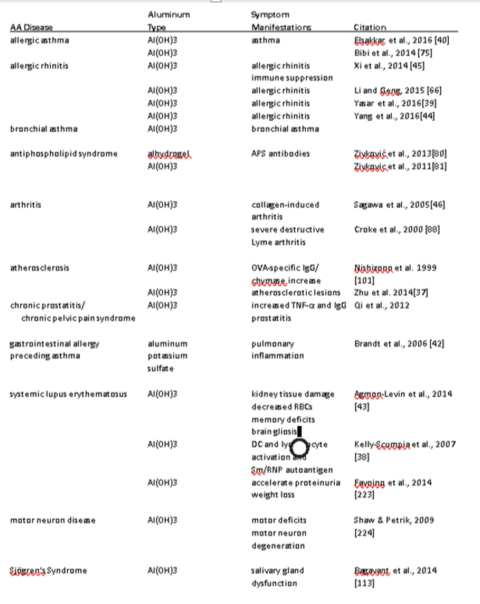

Slide 33
Conditions attributed to Gardasil-9
anaphylaxis,⁶ lupus,⁷ ⁸ erythema multiforme,⁹ acute disseminated encephalomyelitis,¹⁰ ¹¹ ¹² transverse myelitis,¹³ amyotrophic lateral sclerosis (ALS),¹⁴ central nervous system demyelination,¹⁵ ¹⁶ multiple sclerosis,¹⁷ including pediatric multiple sclerosis,¹⁸ Guillain-Barre Syndrome,¹⁹ ²⁰ pancreatitis,²¹ ²² inflammatory bowel syndrome,²³ brachial plexus neuritis,²⁴ brachial neuritis,²⁵ optic neuritis,²⁶ neuromyelitis optica,²⁷ opsoclonus myoclonus,²⁸ evanescent white dot syndrome,²⁹ ³⁰ acute cerebellar ataxia,³¹ autoimmune hepatitis,³² autoimmune neuromyotonia,³³ vasculitis,³⁴ thrombocytopenic purpura,³⁵ immune thrombocytopenic purpura,³⁶ Postural Orthostatic Tachycardia Syndrome (POTS),³⁷ ³⁸ ³⁹ Complex Regional Pain Syndrome (CRPS),⁴⁰ Chronic Fatigue Syndrome (CFS),⁴¹ and peripheral sympathetic nerve dysfunction.⁴² A published questionnaire⁴³ of HPV vaccination recipients focusing on a combination of chronic illness including POTS, CRPS, and fibromyalgia found that 93 percent of individuals reporting symptoms related to these conditions were still incapacitated and unable to work or attend school four years after vaccination. Additionally, several studies have linked HPV vaccination to primary ovarian failure resulting in impaired fertility⁴⁴ ⁴⁵ ⁴⁶ ⁴⁷.
Source: NVIC - https://www.nvic.org/vaccines-and-diseases/hpv/vaccine-injury.aspx

Slide 34
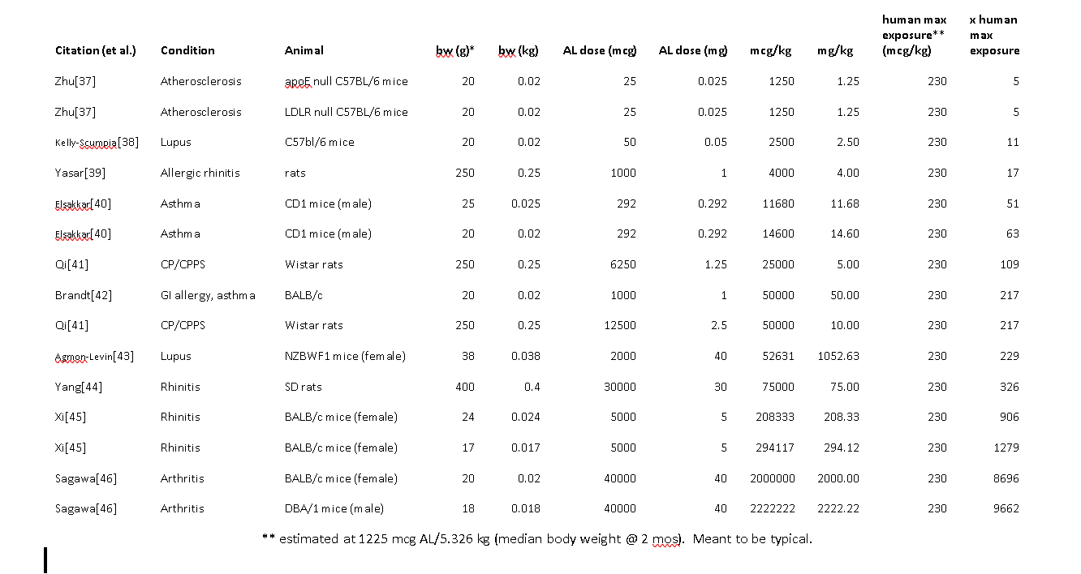

Slide 35
x Human
Max
AL
per
Vaccine
Dose
@ 2 mo
(no units)
Genetic susceptibility models

Slide 38
2019 Vaxxed vs. Unvaxxed Study
http://ipaknowledge.org

